Slide 1
Object Oriented Software Development
A look at the key concepts
Dr. John Kanyaru
Director of UG Studies
Heriot-Watt University Dubai Campus

Slide 2
Lecture Outline
Introduction
Key OO Principles & concepts
How do I:
  write a class?
  create an object/ instance?
  define a method and its parameters?

Slide 3
Introduction
Education
  BSc (Computer Science)
  PhD – Software Engineering
Lecturing experience
Industrial experience
Research interests
More here:
  http://www.macs.hw.ac.uk/~jmk2/

Slide 4
What is a Class?
In the real world, you'll often find many individual objects all of the same kind.
E.g. There may be thousands of dogs, all of different breed and colour.
In object-oriented terms, we say that your dog is an instance of the class of objects known as dogs.
A class is the blueprint from which individual objects are created.

Slide 5




What is an Object?
Objects have a state and behaviour.
State:
Name=x;
Age=y;
Colour=brown, yellow…;
Breed=mongrel, greyhound,…;
Mood=scared, eager,…;
Behaviour:
barking(postman)
fetch(bone)
wagging(tail)
Real-world objects: multiple instances of “dog”.

Slide 6
Example Implementation
public class Dog
{
// Characteristics shared by all dogs (class variables).
// The max age to which a dog can live.
private static final int MAX_AGE = 18;
// Individual characteristics (instance fields).
// The dog's age.
private int age;
// The dog's breed.
private String breed;
public Dog(String breed)
{
age = 0;
this.breed=breed;
}
private void fetch(Object o){
[…]
}
}
FIELDS
CONSTRUCTOR
METHODS

Slide 7
Access Modifiers
public modifier:
  the field is accessible from all classes.
private modifier:
  the field is accessible only within its own class.

Slide 8
Defining Methods
Modifiers—such as public, private, and others.
The return type—the data type of the value returned by the method, or void if the method does not return a value.
The method name—verb starting with lower case.
The parameter list in parenthesis ()
An exception list—to handle unexpected behaviour.
The method body, enclosed between braces—the method's code, including the declaration of local variables, goes here.
public void hunt(Object o){
int attempt= 0;
[…] attempt++;
}
private Boolean hunt(Animal animal){
Boolean success = false;
if (!animal.isAlive()) {
success = true;
}
return success;
}

Slide 9
Example: Generating class instances
public class Simulator
{
// class fields omitted
// Instance field: A population generator.
private PopulationGenerator generator;
/**
* Constructor
**/
public Simulator()
{
// methods omitted
// Create a population generator. NEW
generator = new PopulationGenerator();
// Setup a valid starting point.
reset();
}
// methods omitted
}
Declaration
Instantiation & Initialisation

Slide 10
Example: invoking methods
public class Simulator
{ // fields omitted, constructor omitted
/**
* Reset the simulation to a starting position.
*/
public void reset()
{
step = 0;
// first delete old animals
animals.clear();
// generate a new population
generator.populate(field, animals);
updateViews();
}
}
Method call “populate” on instance “generator” with arguments “field, animals”

Slide 11
Key Principles of OOP
Abstraction & Composition
  (aka “Modularisation”)
Encapsulation & Information hiding
Inheritance
Polymorphism
Notes:
Some of the principles are known under various names.

Slide 12
OOP Principle 1:
Abstraction & Composition
Use objects as building blocks to construct complex systems from more manageable sub-components.
Focus on has-a relationship.
High cohesion: The term cohesion describes how well a unit of code maps to a logical task or entity. Good class design exhibits a high degree of cohesion.

Slide 13
Methods for Composition & Abstraction
How to identify and design a class?
Responsibility-driven design:
  What actions is this object responsible for?
  What information does this object share?
Use UML diagrams
Refactor within an iterative design methodology.

Slide 14
OOP Principle 2:
Encapsulation/ Information hiding
Internal details of a class’ implementation should be hidden from other classes. It ensures better modularisation of an application.
Loose coupling: Coupling describes the inter-connectedness of classes. Loose coupling means that each class is largely independent and communicates with other via well-defined interfaces.

Slide 15
Methods for Encapsulation & Information Hiding
Access control: modifiers for methods and variables, e.g., public vs. private.
Java interfaces.
Interface Dog {
void run();
void bark( );
}
Class Greyhound implements Dog {
void run(){
velocity++;
}
}

Slide 16
OOP Principle 3: Inheritance
Use class inheritance to extend and re-use existing fields and methods of an existing class.
Focus on is-a relationship
Inheritance tree: Super-class and subclasses.
Implemented with “extends” keyword.

Slide 17
Java and Inheritance
Java only supports single inheritance (using “extend” keyword).
Multiple inheritance can be emulated using Java Interfaces.
Class Animal // Super class
{
//member declarations
}
Class Dog extends Animal //sub class
{
// member declarations
}

Slide 18
OOP Principle 4:
Polymorphism
Method Overriding: A subclass can override a method in the superclass by declaring a method with the same signature, but with a different method body.
Dynamic method lookup: the overriding method takes precedence for method calls on subclass objects.
Notes:
Annotations provide data about a program that is not part of the program itself. They have no direct effect on the operation of the code they annotate.
Annotations have a number of uses, among them:
+ Information for the compiler — Annotations can be used by the compiler to detect errors or suppress warnings.
+ Increase readability of code

Slide 19
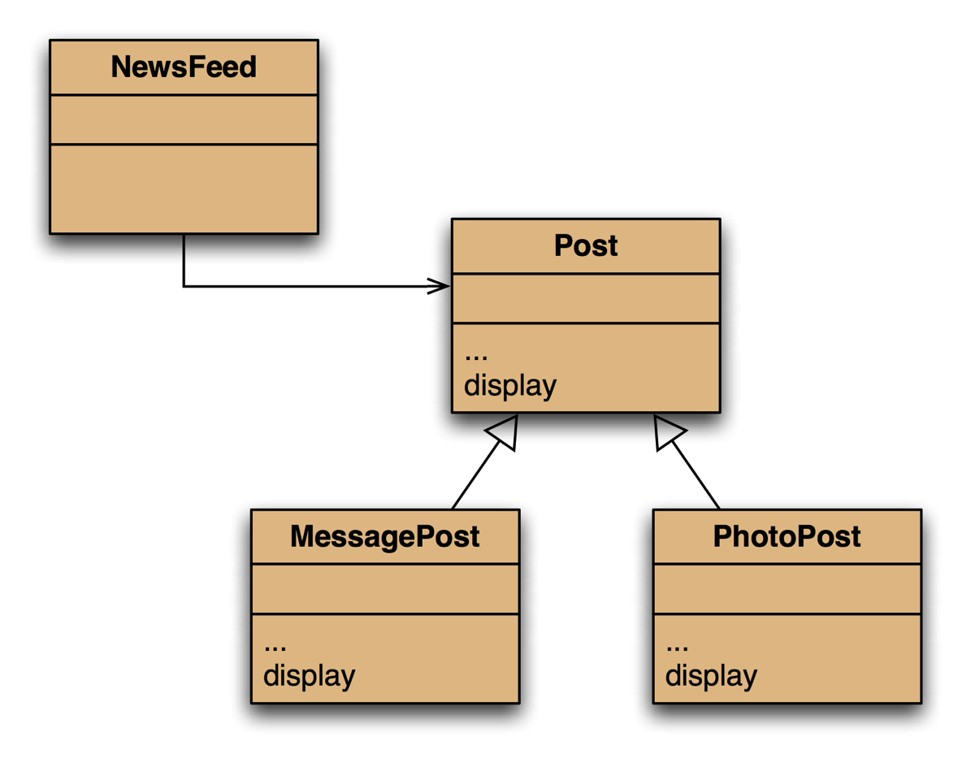
Overriding: the solution
display method in both super- and subclasses.

Slide 20
Summary
4 OOP Principles thrive for high cohesion and loose coupling.
Class definitions have fields, a constructor and methods.
Methods have parameters when defined and arguments when called.

Slide 21
Thank you!

